Slide 1
Lesson 6: Relational Algebra
CSC430/530 – DATABASE MANAGEMENT SYSTEMS

Slide 2
OUTLINE
Introduction.
Unary relational operations.
SELECT, PROJECT, RENAME.
Set theory relational operations.
UNION, INTERSECTION, SET DIFFERENCE, CARTESIAN PRODUCT.
Binary relational operations.
JOIN, DIVISION.
Additional relational operations.
Aggregation and grouping.

Slide 3
INTRODUCTION
Why relational algebra?
Formal foundation for relational model operations.
Basis of query implementation and optimization.
Many concepts are incorporated in SQL.
Relational algebra defines the basic set of operations for the relational data model.
Operations allow user to specify basic retrieval request.
Result of such a retrieval query is a new relation.
New relation can be further manipulated using same operations, forming relational algebra expression.

Slide 4
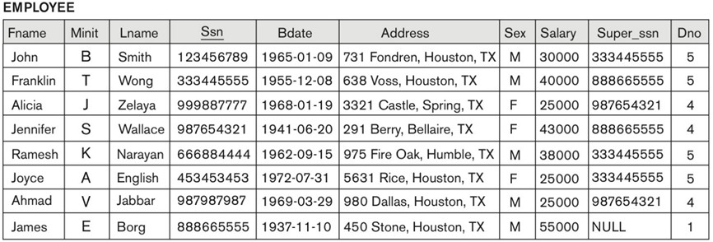
UNARY RELATIONAL OPERATIONS: SELECT (1)
Selects a subset of the tuples from a relation based on a selection condition.
Denoted by σ (sigma).
Acts as a filter – keeps only those tuples that satisfy the selection condition.
^{σ}<selection condition>^{(R)}
Selection condition – Boolean expression on attributes of relation R.
<attribute name><comparison op><constant value> or <attribute name><comparison op><attribute name>
Examples:
Retrieve the EMPLOYEE tuples whose department number is 4:
σ _{Dno = 4} (EMPLOYEE)
Retrieve the EMPLOYEE tuples whose salary is
greater than $30,000:
^{σ} Salary > 30000 ^{(EMPLOYEE)}

Slide 5
UNARY RELATIONAL OPERATIONS: SELECT (2)
Properties:
Operation produces new relation that has same attributes as R.
The number of tuples in resulting relation is always less than (or equal to) the number of tuples in R.
Operation is commutative.
^{σ} <cond1>^{(σ} < cond2> ^{(R)) = σ} <cond2> ^{(σ} < cond1> ^{(R))}
Can be cascaded into single operation.
^{σ}<cond1>^{(σ}< cond2> ^{(σ}<cond3>^{(R))) = σ} <cond1> AND < cond2> AND < cond3>^{(R)}

Slide 6
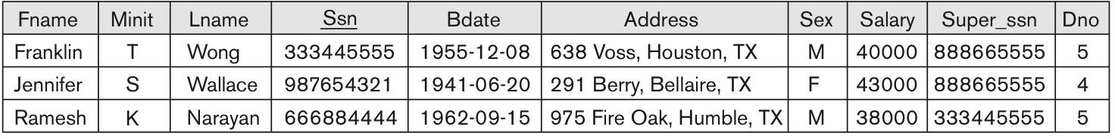
UNARY RELATIONAL OPERATIONS: SELECT (3)
Example: Retrieve employees who either work in department 4 and make over $25,000 per year or
work in department 5 and make over $30,000.
^{σ} (Dno = 4 AND Salary > 25000) OR (Dno = 5 AND Salary > 30000) ^{(EMPLOYEE)}

Slide 7
UNARY RELATIONAL OPERATIONS: PROJECT (1)
Keeps certain columns (attributes) from a relation and discards the other columns.
Only the list of specified columns (attributes) is kept in each tuple.
Denoted by π (pi).
^{π}<attribute list>^{(R)}
Attribute list – desired list of attributes from relation R.
Example:
List each employee’s last name, first name, and salary.
^{π} Lname, Fname, Salary ^{(EMPLOYEE)}
Removes any duplicate tuples.
Because the result of operation is a new relation
(set of tuples).

Slide 8
UNARY RELATIONAL OPERATIONS: PROJECT (2)
Properties:
The number of tuples in the resulting relation is less than or equal to the number of tuples in R.
Equals only when the list of attributes includes a key of R.
Operation is not (generally) commutative.
π _{<list1>} (π _{<list2>} (R)) = π _{<list2>} (π _{<list1>} (R)), only if <list2> contains the same attributes as in <list1>.

Slide 9
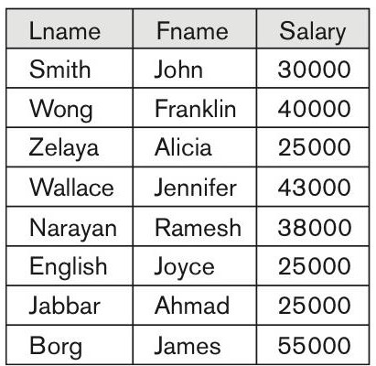
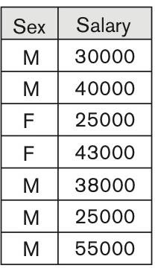
UNARY RELATIONAL OPERATIONS: PROJECT (3)
Examples:
π
(EMPLOYEE)
π _{Sex, Salary} (EMPLOYEE)
Lname, Fname, Salary

Slide 10
UNARY RELATIONAL OPERATIONS: RENAME (1)
Relational operations can be nested to an arbitrary depth.
Retrieve first name, last name and salary of employees who work for department 5.
^{π} Fname, Lname, Salary ^{(σ} Dno = 5 ^{(EMPLOYEE))}
Alternatively, same operation can be rewritten by the sequence of operation, giving names to
intermediate relations.
DEP5_EMPS ← σ _{Dno = 5} (EMPLOYEE)
RESULT ← π _{Fname, Lname, Salary} (DEP5_EMPS)
Attributes names can also be renamed if needed.
TEMP ← σ _{Dno = 5} (EMPLOYEE)
R(First_name, Last_name, Salary) ← π _{Fname, Lname, Salary} (TEMP)

Slide 11
UNARY RELATIONAL OPERATIONS: RENAME (2)
General RENAME operation ρ (rho) can be expressed by any of the following forms:
ρ _{S (B1, B2, …, Bn)} (R) changes both:
the relation name to S, and
the column (attribute) names to B₁, B₂, …, B_{n}.
ρ _{S} (R) changes:
the relation name only, to S.
ρ _{(B1, B2, …, Bn )} (R) changes:
the column (attribute) names only, to B₁, B₂, …, B_{n}.

Slide 12
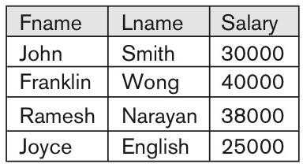
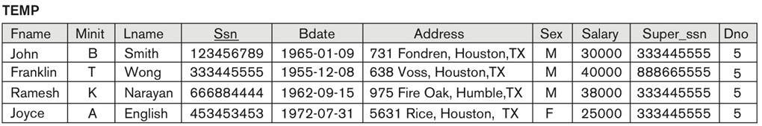
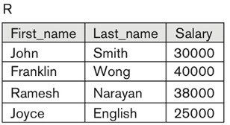
UNARY RELATIONAL OPERATIONS: RENAME (3)
Example: Retrieve first name, last name and salary of employees who work for department 5.
^{π} Fname, Lname, Salary ^{(σ} Dno=5 ^{(EMPLOYEE))}
TEMP ← σ _{Dno = 5} (EMPLOYEE)
R(First_name, Last_name, Salary) ← π _{Fname, Lname, Salary} (TEMP)

Slide 13
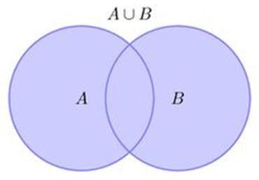
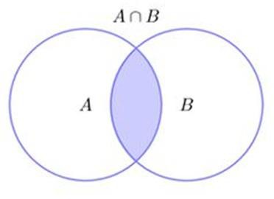
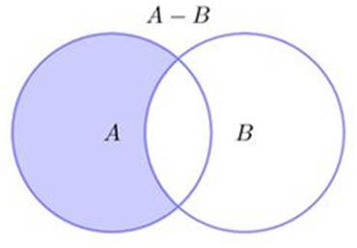
UNION, INTERSECTION & SET DIFFERENCE (1)
Union operation: A ∪ B.
The result is a relation that includes all tuples that are either in A or in B or in
both.
Duplicate tuples are eliminated.
Intersection operation: A ∩ B.
The result is a relation that includes all tuples that are in both A and B.
The attribute names in the result will be the same as the attribute names in A.
Set difference operation: A – B.
The result is a relation that includes all tuples that are in A but not in B.
The attribute names in the result will be the same as the attribute names in A.
The two operand relations A and B must be type compatible.
Same number of attributes.
Pair of attributes must be from same (compatible) domain.

Slide 14
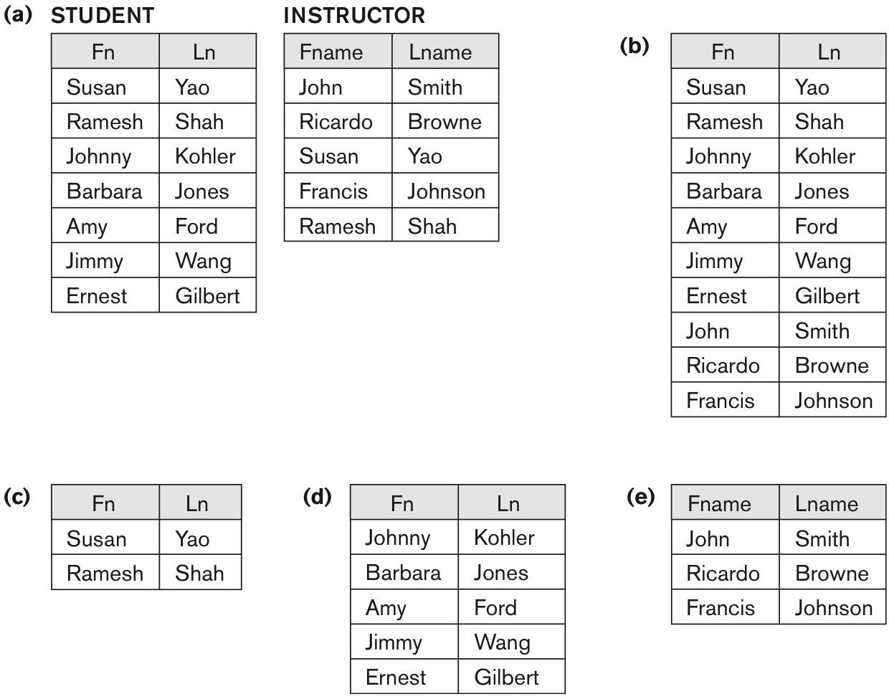
UNION, INTERSECTION & SET DIFFERENCE (2)
Examples:
(a) Two compatible relations.
(b) STUDENT ∪ INSTRUCTOR.
(c) STUDENT ∩ INSTRUCTOR.
(d) STUDENT – INSTRUCTOR.
(e) INSTRUCTOR – STUDENT.

Slide 15
UNION, INTERSECTION & SET DIFFERENCE (3)
Properties:
Union & intersection are commutative.
A ∪ B = B ∪ A, and A ∩ B = B ∩ A
Union & intersection are associative and can be treated as n-ary operations.
A ∪ (B ∪ C) = (A ∪ B) ∪ C
(A ∩ B) ∩ C = A ∩ (B ∩ C)
Set difference is NOT commutative.
A – B ≠ B – A

Slide 16
CARTESIAN PRODUCT (1)
Used to combine tuples from two relations in a combinatorial fashion.
R(A₁, A₂, …, A_{n}) x S(B₁, B₂, ..., B_{m})
Results in a relation Q with n + m attributes.
Q(A₁, A₂, ..., A_{n}, B₁, B₂, ..., B_{m}), in that order.
State of relation Q has one tuple for each combination of tuples – one from R and one from S.

Slide 17
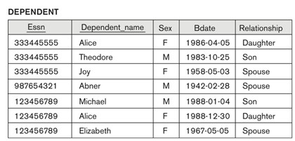
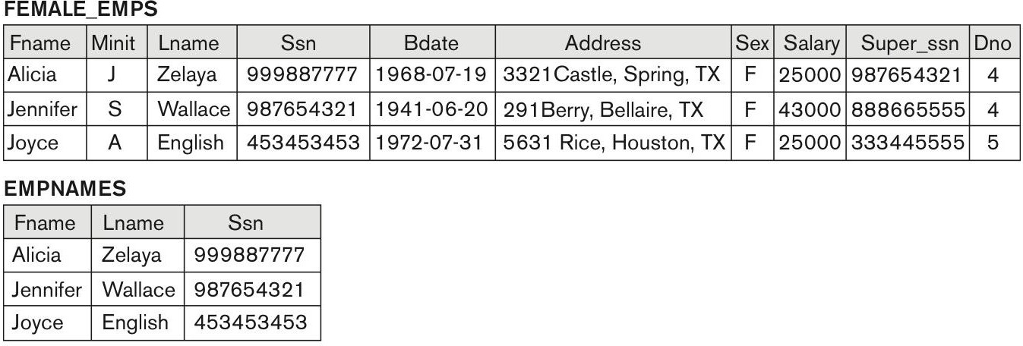
CARTESIAN PRODUCT (2)
Generally, the result of Cartesian product is not meaningful.
It only becomes meaningful when followed by other operations.
Example: List names of female employees and their dependents.
FEMALE_EMPS ← σ _{Sex = ’F’} (EMPLOYEE)
EMPNAMES ← π _{Fname, Lname, Ssn} (FEMALE_EMPS) EMP_DEPENDENTS ← EMPNAMES x DEPENDENT

Slide 18
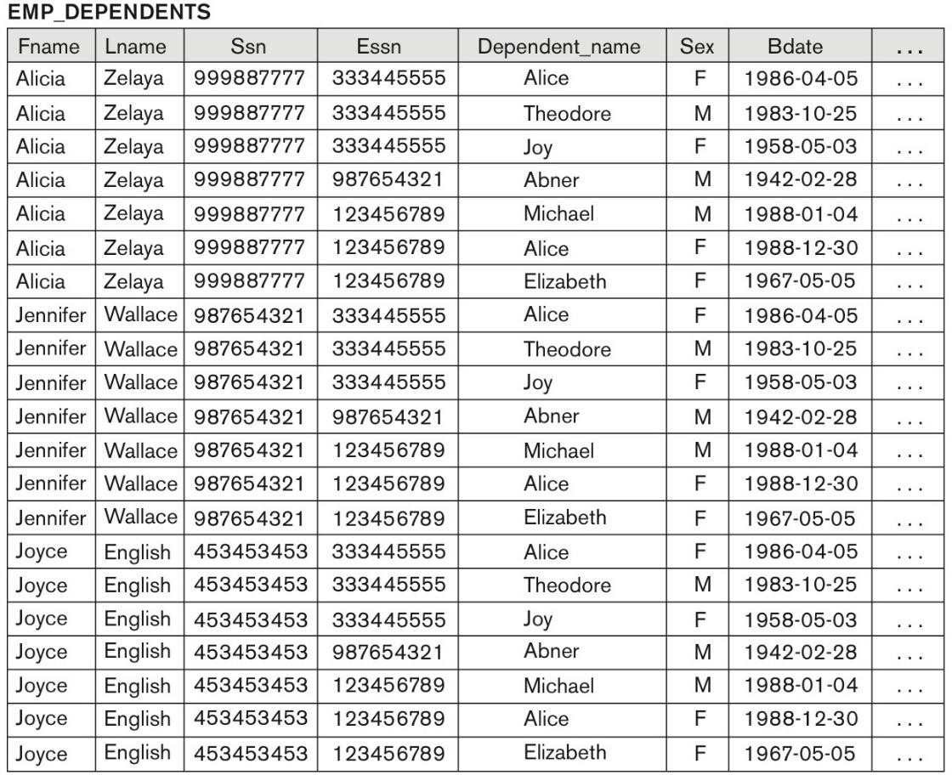
CARTESIAN PRODUCT (3)
Generally, the result of Cartesian product is not meaningful.
It only becomes meaningful when followed by other operations.
Example: List names of female employees and their dependents.
FEMALE_EMPS ← σ _{Sex = ’F’} (EMPLOYEE)
EMPNAMES ← π _{Fname, Lname, Ssn} (FEMALE_EMPS) EMP_DEPENDENTS ← EMPNAMES x DEPENDENT

Slide 19
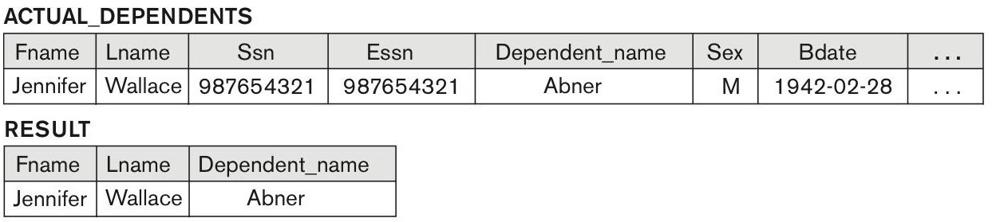
CARTESIAN PRODUCT (4)
Generally, the result of Cartesian product is not meaningful.
It only becomes meaningful when followed by other operations.
Example: List names of female employees and their dependents.
FEMALE_EMPS ← σ _{Sex = ’F’} (EMPLOYEE)
EMPNAMES ← π _{Fname, Lname, Ssn} (FEMALE_EMPS) EMP_DEPENDENTS ← EMPNAMES x DEPENDENT
To make it meaningful, we can add Select and Project
operations.
ACTUAL_DEPS ← σ _{Ssn = Essn} (EMP_DEPENDENTS)
^{RESULT ← π} Fname, Lname, Dependent_name ^{(ACTUAL_DEPS)}

Slide 20
BINARY RELATIONAL OPERATIONS: JOIN (1)
Combines related tuples from two relations into single “longer” tuple.
Allows processing relationships among relations.
Denoted by ⋈
^{R⋈}<join condition> ^{S}
Join condition is specified on attributes from two relations and is evaluated for each combination of tuples.
If condition is True then the combination is included in the resulting relation as a single combined tuple.
Each join condition has a general form A_{i} Θ B_{j}, where
A_{i} is an attribute of R.
B_{j} is an attribute of S.
Θ (theta) is one of the comparisons operators (=, >, ≥, <, ≤, ≠).

Slide 21
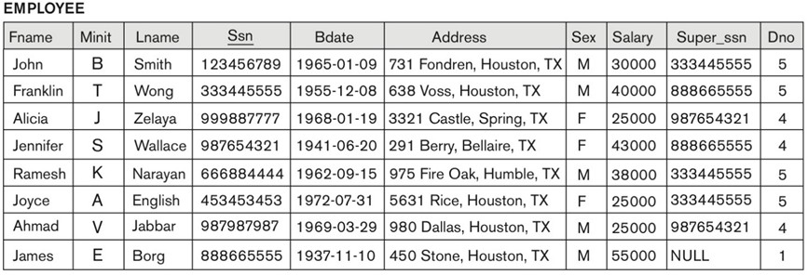
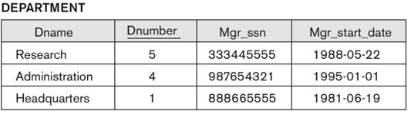
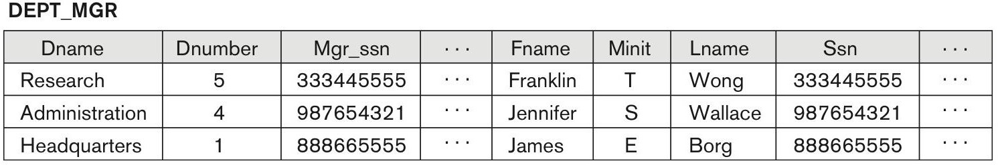
BINARY RELATIONAL OPERATIONS: JOIN (2)
Example: List department managers.
DEPT_MGR ← DEPARTMENT ⋈ _{Mgr_ssn = Ssn} EMPLOYEE

Slide 22
BINARY RELATIONAL OPERATIONS: JOIN (3)
Special cases of Join operation:
EQUIJOIN.
Only “=“ comparison operator is used.
Most common use of JOIN operation.
Results in one or more pairs of attributes that have identical values in every tuple.
NATURAL JOIN.
Removes second (superfluous) attribute in EQUIJOIN.
Two join attributes must have the same name in both relations.
A renaming operation might be applied first.
Denoted by *.

Slide 23
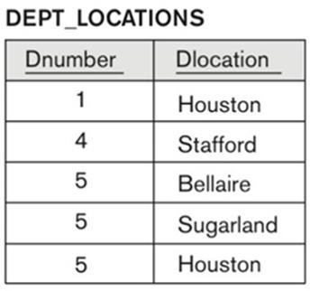
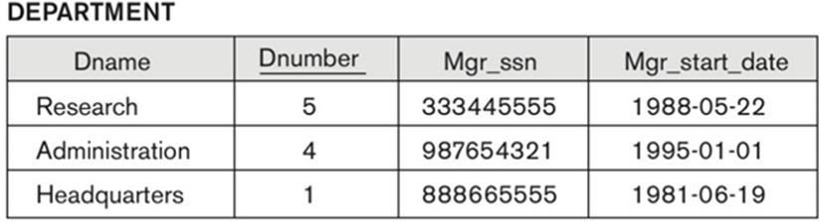
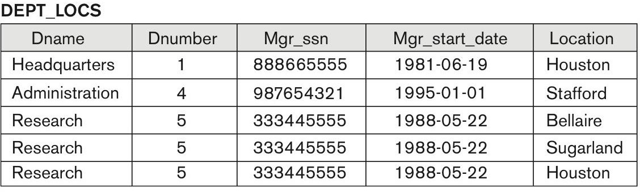
BINARY RELATIONAL OPERATIONS: JOIN (4)
Examples: List departments’ locations.
DEPT_LOCS ← DEPARTMENT * DEPT_LOCATIONS

Slide 24
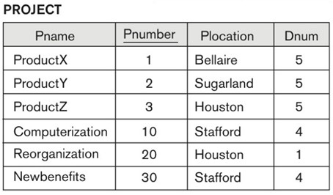
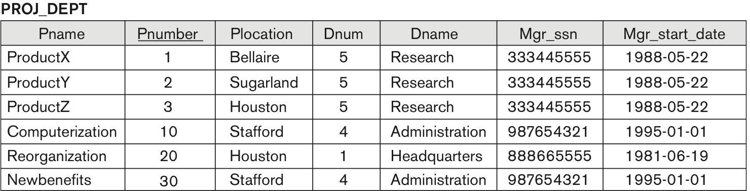
BINARY RELATIONAL OPERATIONS: JOIN (4)
Examples: List projects’ departments.
^{PROJ_DEPT ← PROJECT * ρ}(Dname, Dnum, Mgr_ssn, Mgr_start_date) ^{(DEPARTMENT)}

Slide 25
COMPLETE SET OF RELATIONAL OPERATIONS
The set of operations {σ, π, ∪, −, ρ, x} is called a complete set.
Any other relational algebra expression can be expressed by a combination of these operations.
Examples:
R ∩ S = (R ∪ S ) – ((R − S) ∪ (S − R))
^{R ⋈} <join condition>^{S = σ} <join condition> ^{(R x S)}

Slide 26
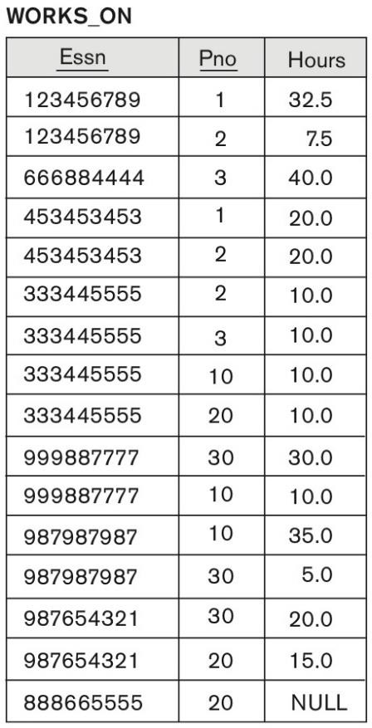
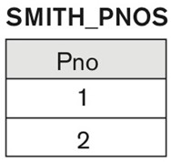
BINARY RELATIONAL OPERATIONS: DIVISION
Denoted by ÷ and applied to two relations R(Z) ÷ S(X) = T(Y).
Attributes of S are a subset of the attributes of R.
Tuples in S restrict R by selecting those tuples that match all values present in S.
Example:
Retrieve the names of employees who work on all the projects that John Smith works on.
^{SMITH ← σ} Fname = ‘John” AND Lname = ‘Smith’ ^{(EMPLOYEE)}
SMITH_PNOS ← π _{Pno} (WORKS_ON ⋈ _{Essn = Ssn} SMITH)
SSN_PNOS ← π _{Essn, Pno} (WORKS_ON)
SSNS(Ssn) ← SSN_PNOS ÷ SMITH_PNOS
RESULT ← π _{Fname, Lname} (SSNS * EMPLOYEE)

Slide 27
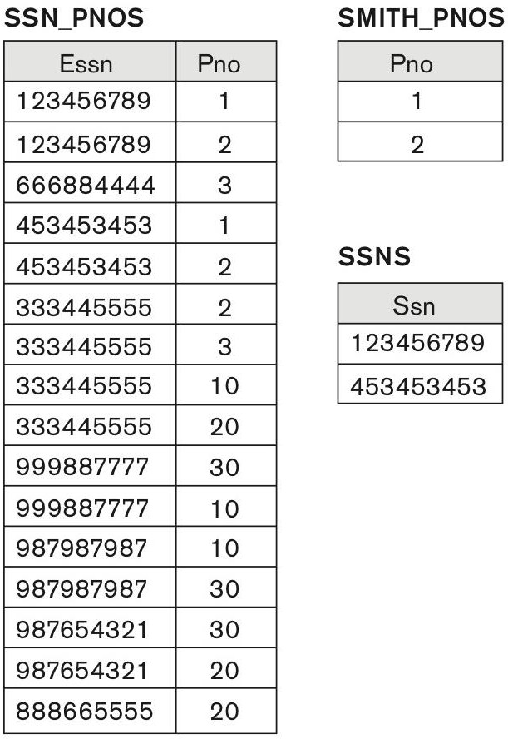
BINARY RELATIONAL OPERATIONS: DIVISION
Denoted by ÷ and applied to two relations R(Z) ÷ S(X) = T(Y).
Attributes of S are a subset of the attributes of R.
Tuples in S restrict R by selecting those tuples that match all values present in S.
Example:
Retrieve the names of employees who work on all the projects that John Smith works on.
^{SMITH ← σ} Fname = ‘John” AND Lname = ‘Smith’ ^{(EMPLOYEE)}
SMITH_PNOS ← π _{Pno} (WORKS_ON ⋈ _{Essn = Ssn} SMITH)
SSN_PNOS ← π _{Essn, Pno} (WORKS_ON)
SSNS(Ssn) ← SSN_PNOS ÷ SMITH_PNOS
RESULT ← π _{Fname, Lname} (SSNS * EMPLOYEE)
RESULT
Fname | Lname
John | Smith
Joyce | English

Slide 28
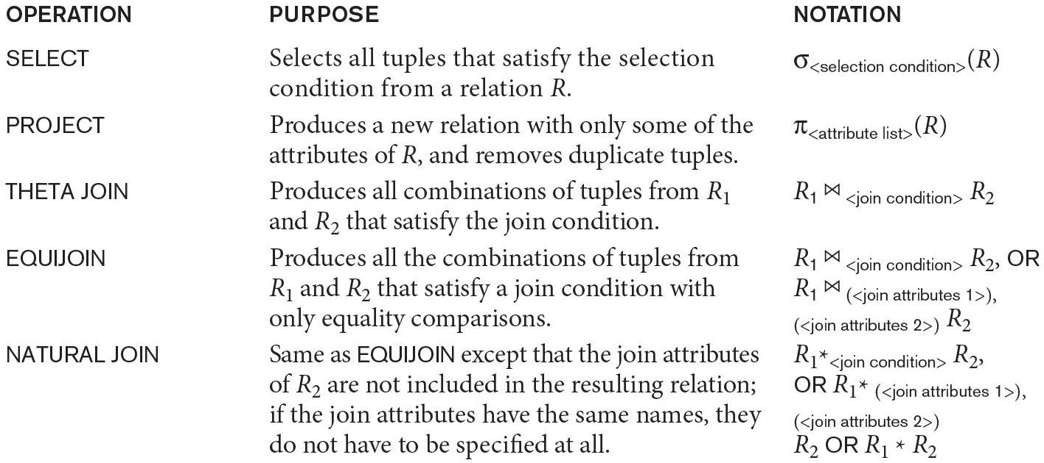
SUMMARY OF RELATIONAL OPERATIONS (1)

Slide 29
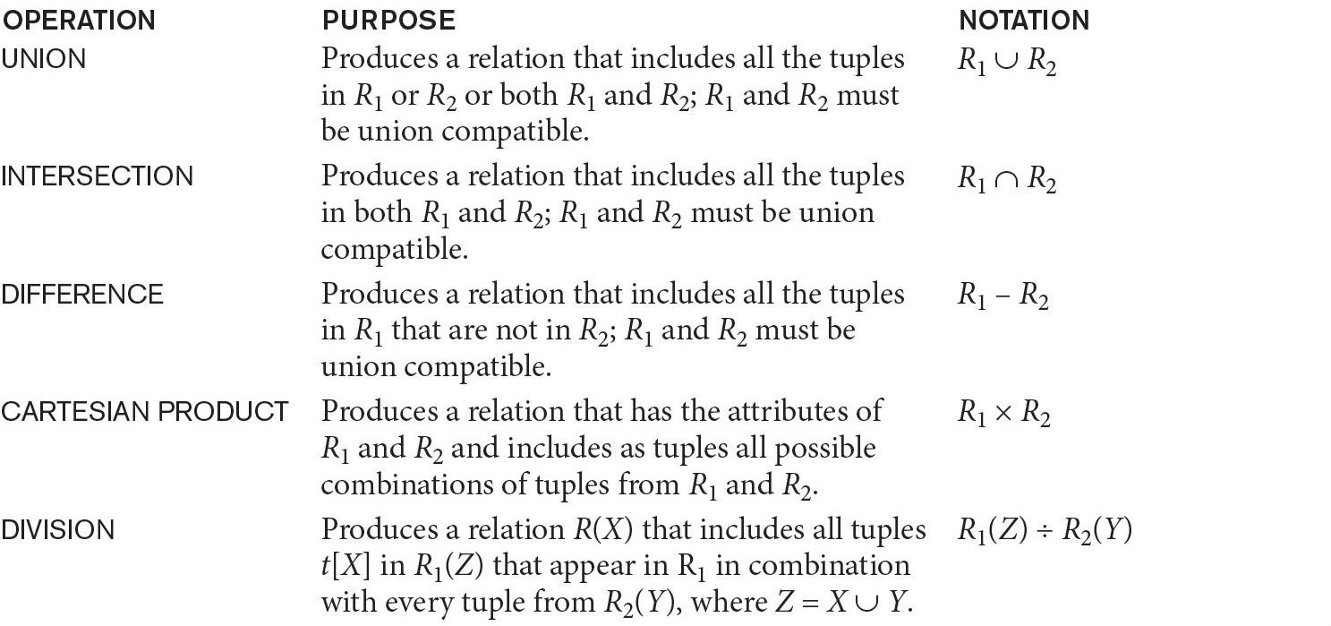
SUMMARY OF RELATIONAL OPERATIONS (2)

Slide 30
AGGREGATION & GROUPING (1)
Specifying simple mathematical aggregate functions on collections of values from the database cannot be directly expressed in the basic relational algebra.
For example - get average or total salary of all employees or the total number of employee tuples.
SUM, AVERAGE, MAXIMUM, MINIMUM, COUNT.
Grouping operation and aggregate functions are used for this purpose.
<grouping attributes> ^{ℑ} <function list> ^{(R)}
Grouping attributes - list of attributes of the relation R.
Function list - list of (<function> <attribute>) pairs.

Slide 31
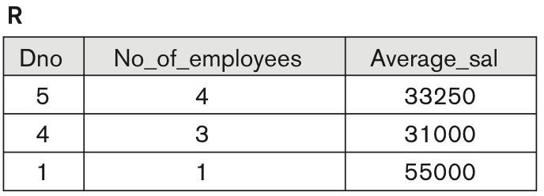
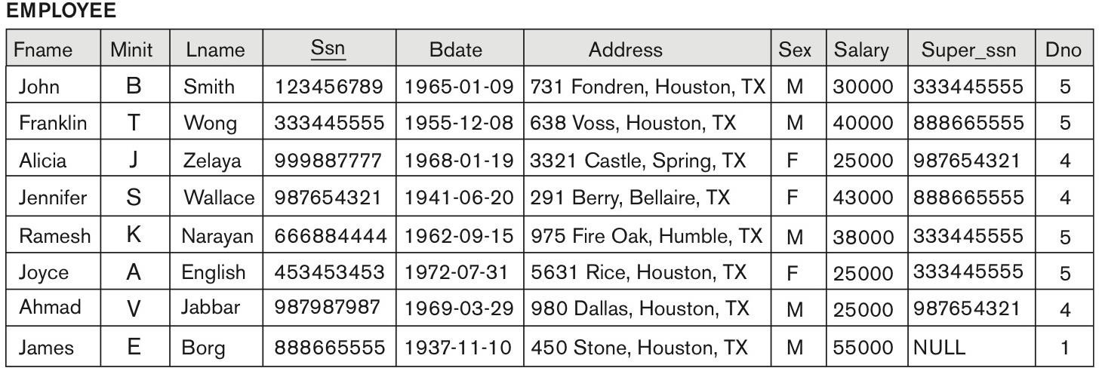
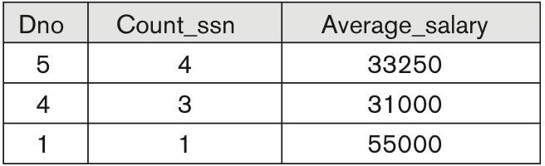
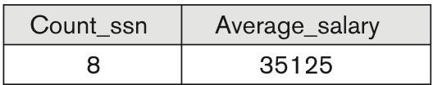
AGGREGATION & GROUPING (2)
Example: Retrieve each department number, the number of employees in the department, and their
average salary.
^{ρ}R(Dno, No_of_employees, Average_sal)⁽Dno ^{ℑ} COUNT Ssn, AVERAGE Salary ^{(EMPLOYEE))}
Dno ^{ℑ} COUNT Ssn, AVERAGE Salary ^{(EMPLOYEE)}
^{ℑ} COUNT Ssn, AVERAGE Salary ^{(EMPLOYEE)}

Slide 32
SUMMARY
Unary operations.
Select, project, rename.
Set theory operations.
Union, intersection, set difference, Cartesian product.
Binary operations.
Joins, division.
Additional relational operations.
Aggregation, grouping.

Slide 33
EXAMPLES OF QUERIES
Query 1.
Retrieve the name and address of all employees who work for the ‘Research’ department.

Slide 34

EXAMPLES OF QUERIES
Query 1.
Retrieve the name and address of all employees who work for the ‘Research’ department.

Slide 35
EXAMPLES OF QUERIES
Query 1.
Retrieve the name and address of all employees who work for the ‘Research’ department.
Single in-line version:
Note: This query could be specified in other ways. For example, the order of the JOIN and SELECT operations could be reversed, or the JOIN could be replaced by a NATURAL JOIN after renaming one of the join attributes to match the other join attribute name.

Slide 36
EXAMPLES OF QUERIES
Query 2.
For every project located in ‘Stafford’, list the project number, the controlling department number, and the department manager’s last name, address, and birth date.

Slide 37
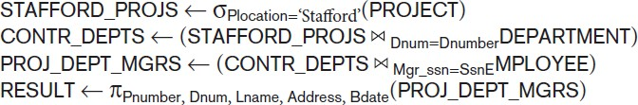
EXAMPLES OF QUERIES
Query 2.
For every project located in ‘Stafford’, list the project number, the controlling department number, and the department manager’s last name, address, and birth date.

Slide 38
EXAMPLES OF QUERIES
Query 2.
For every project located in ‘Stafford’, list the project number, the controlling department number, and the department manager’s last name, address, and birth date.
Note: In this example, we first select the projects located in Stafford, then join them with their controlling departments, and then join the result with the department managers. Finally, we apply a project operation on the desired attributes.

Slide 39
EXAMPLES OF QUERIES
Query 3.
Find the names of employees who work on all the projects controlled by department number 5.

Slide 40
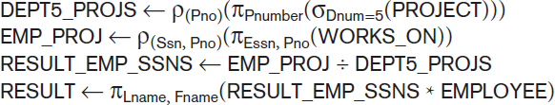
EXAMPLES OF QUERIES
Query 3.
Find the names of employees who work on all the projects controlled by department number 5.

Slide 41
EXAMPLES OF QUERIES
Query 3.
Find the names of employees who work on all the projects controlled by department number 5.
Note: In this query, we first create a table DEPT5_PROJS that contains the project numbers of all projects controlled by department 5. Then we create a table EMP_PROJ that holds (Ssn, Pno) tuples, and apply the division operation. Notice that we renamed the attributes so that they will be correctly used in the division operation. Finally, we join the result of the division, which holds only Ssn values, with the EMPLOYEE table to retrieve the Fname, Lname attributes from EMPLOYEE.

Slide 42
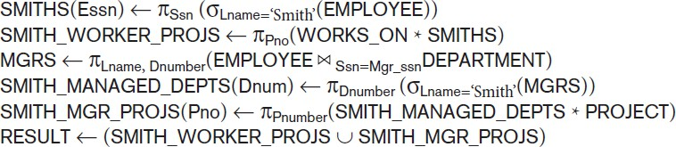
EXAMPLES OF QUERIES
Query 4.
Make a list of project numbers for projects that involve an employee whose last name is ‘Smith’,
either as a worker or as a manager of the department that controls the project.
Note: In this query, we retrieved the project numbers for projects that involve an employee named Smith as a worker in SMITH_WORKER_PROJS. Then we retrieved the project numbers for projects that involve an employee named Smith as manager of the department that controls the project in SMITH_MGR_PROJS. Finally, we applied the UNION operation on SMITH_WORKER_PROJS and SMITH_MGR_PROJS.

Slide 43
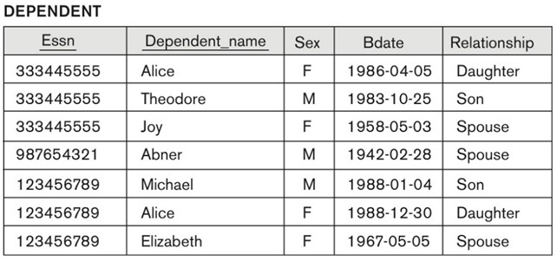
EXAMPLES OF QUERIES
Query 5.
List the names of all employees with more than two dependents.

Slide 44

EXAMPLES OF QUERIES
Query 5.
List the names of all employees with more than two dependents.

Slide 45
EXAMPLES OF QUERIES
Query 5.
List the names of all employees with more than two dependents.
Note: For this query, we have to use the AGGREGATE FUNCTION operation with the COUNT aggregate function. We assume
that dependents of the same employee have distinct Dependent_name values.

Slide 46
EXAMPLES OF QUERIES
Query 6.
Retrieve the names of employees who have no dependents.

Slide 47
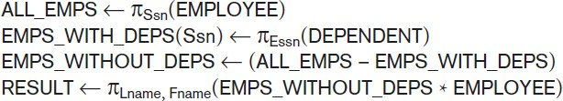
EXAMPLES OF QUERIES
Query 6.
Retrieve the names of employees who have no dependents.

Slide 48
EXAMPLES OF QUERIES
Query 6.
Retrieve the names of employees who have no dependents.
Note: We first retrieve a relation with all employee Ssns in ALL_EMPS. Then we create a table with the Ssns of employees who have at least one dependent in EMPS_WITH_DEPS. Then we apply the SET DIFFERENCE operation to retrieve employees Ssns with no dependents in EMPS_WITHOUT_DEPS, and finally join this with EMPLOYEE to retrieve the desired attributes.

Slide 49
EXAMPLES OF QUERIES
Query 7.
List the names of managers who have at least one dependent.

Slide 50
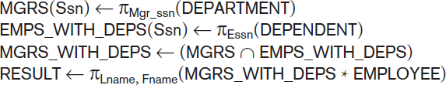
EXAMPLES OF QUERIES
Query 7.
List the names of managers who have at least one dependent.

Slide 51
EXAMPLES OF QUERIES
Query 7.
List the names of managers who have at least one dependent.
Note: In this query, we retrieve the Ssns of managers in MGRS, and the Ssns of employees with at least one dependent in EMPS_WITH_DEPS, then we apply the SET INTERSECTION operation to get the Ssns of managers who have at least one dependent.

